Slide 1
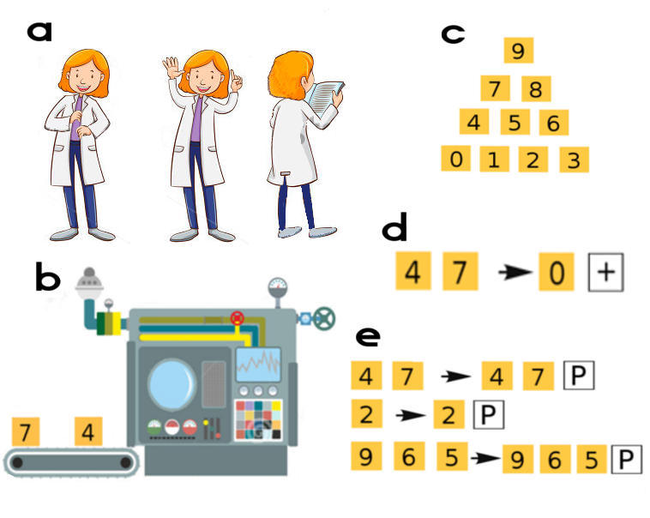
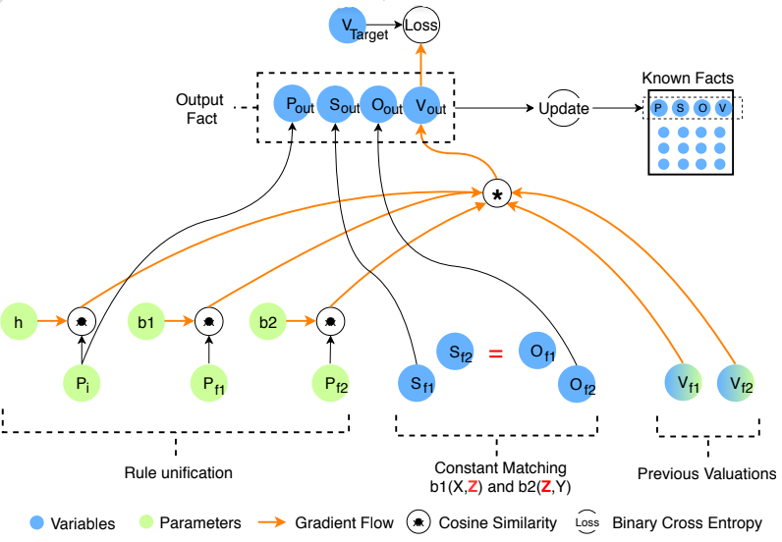
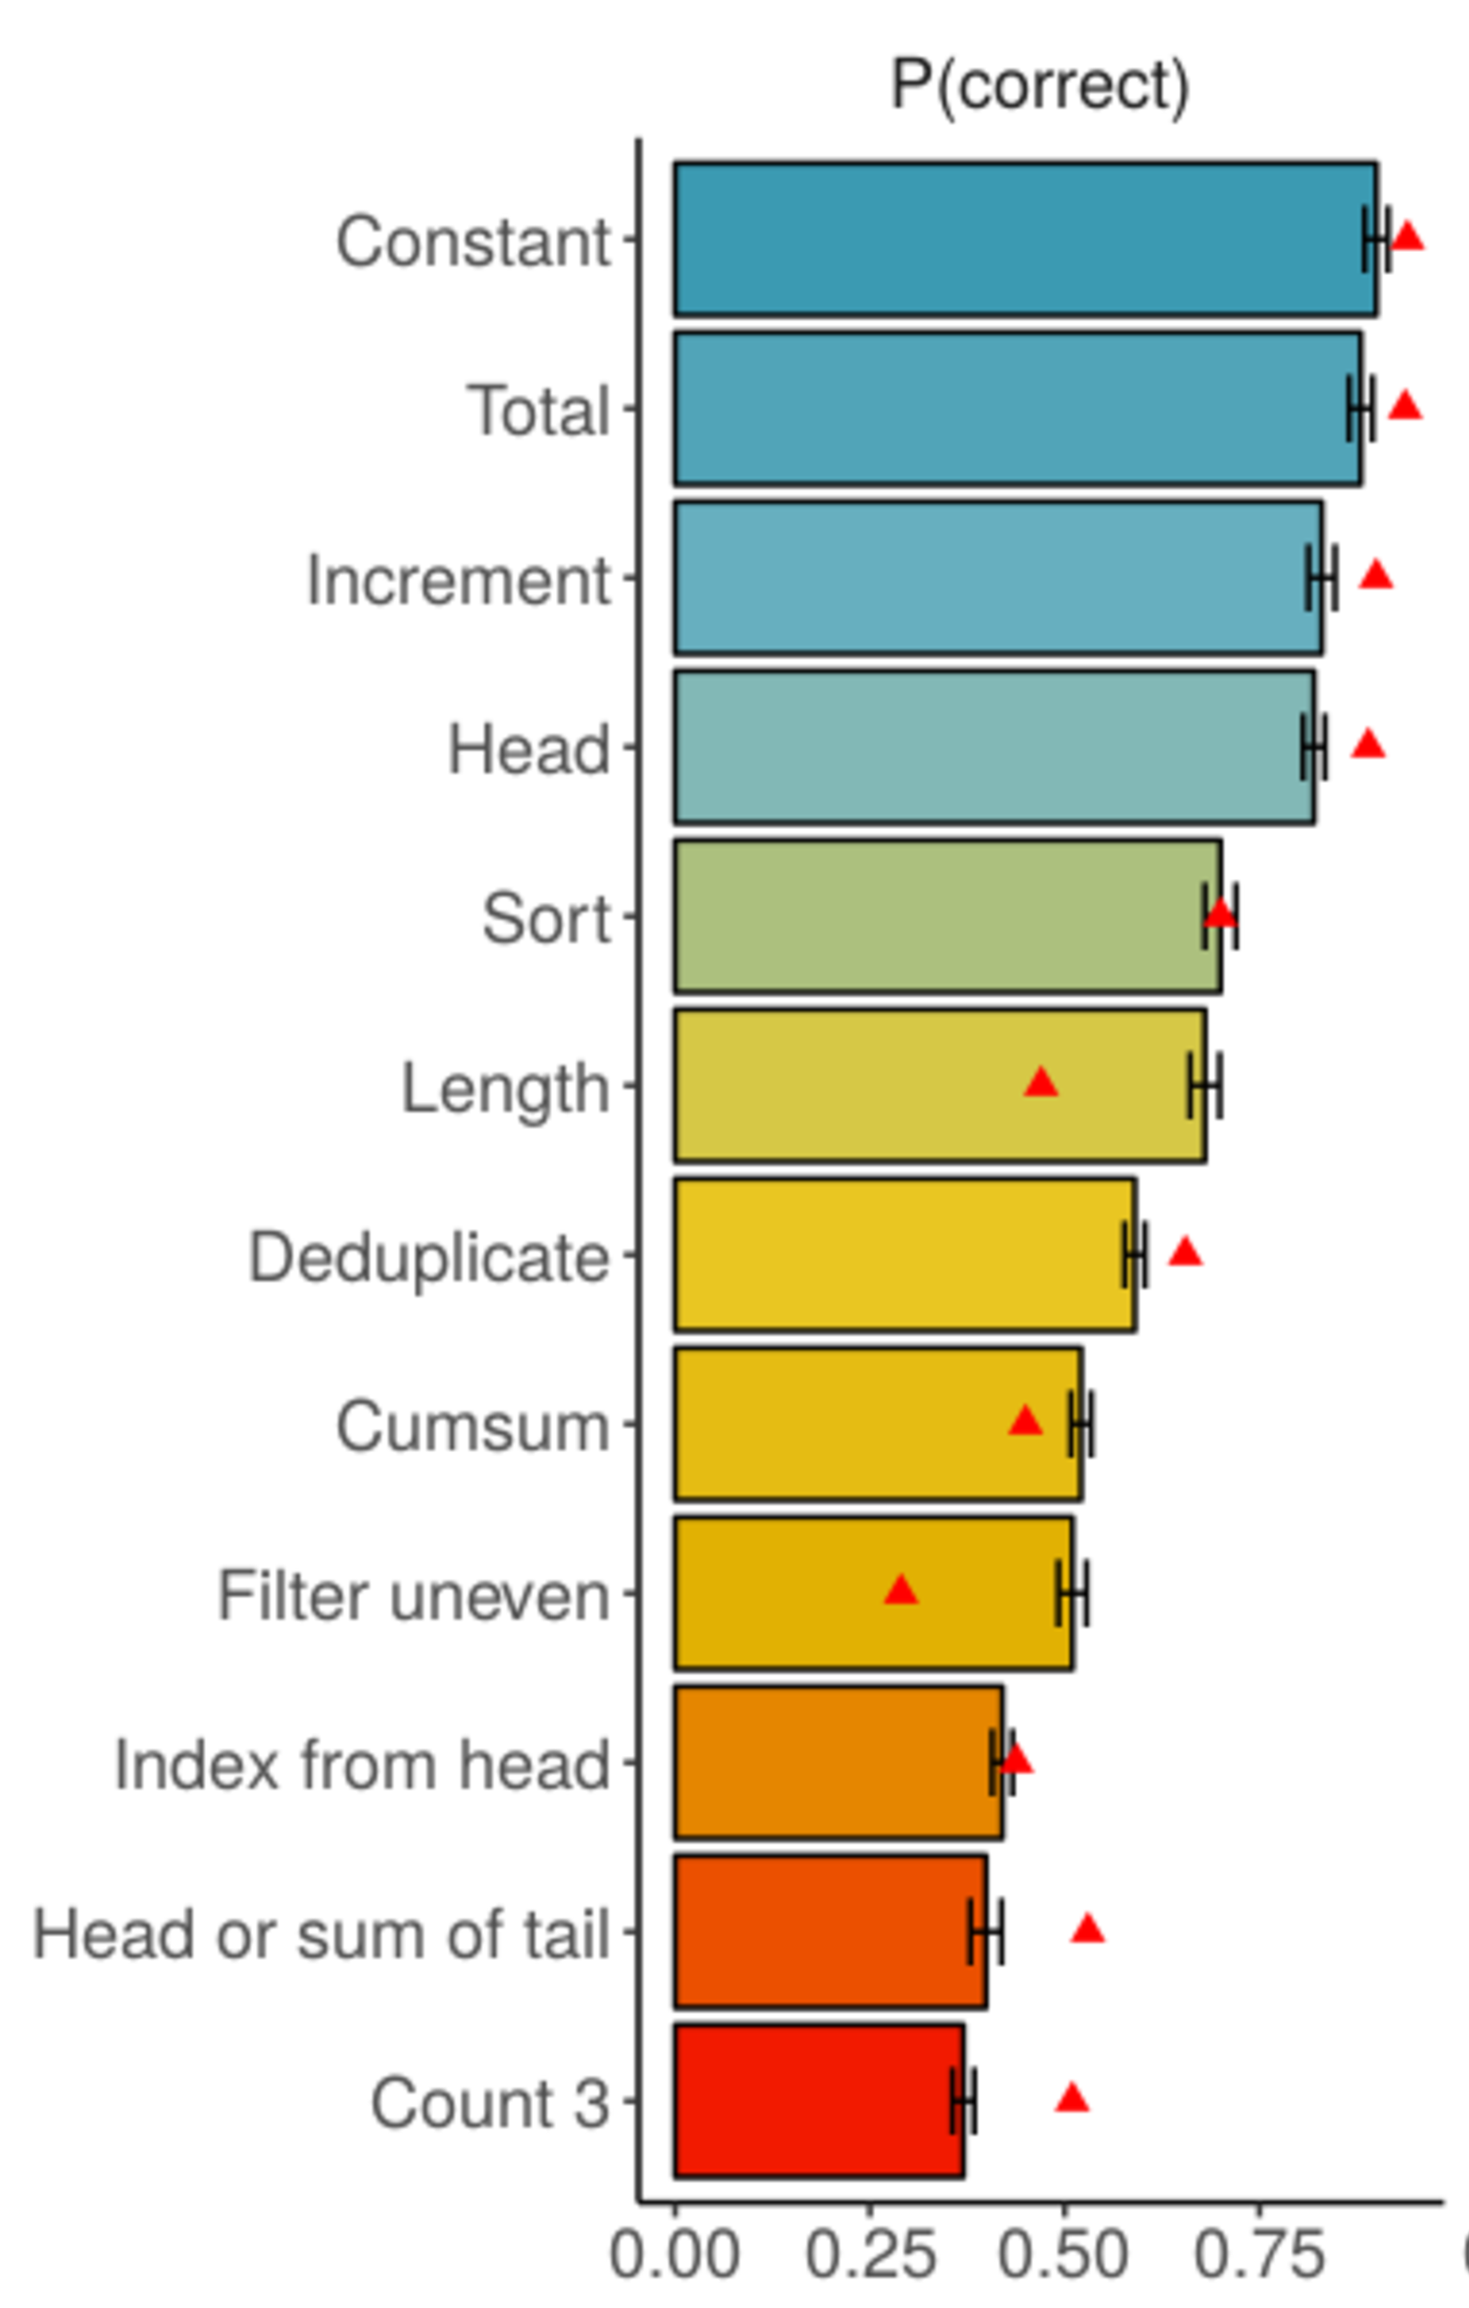
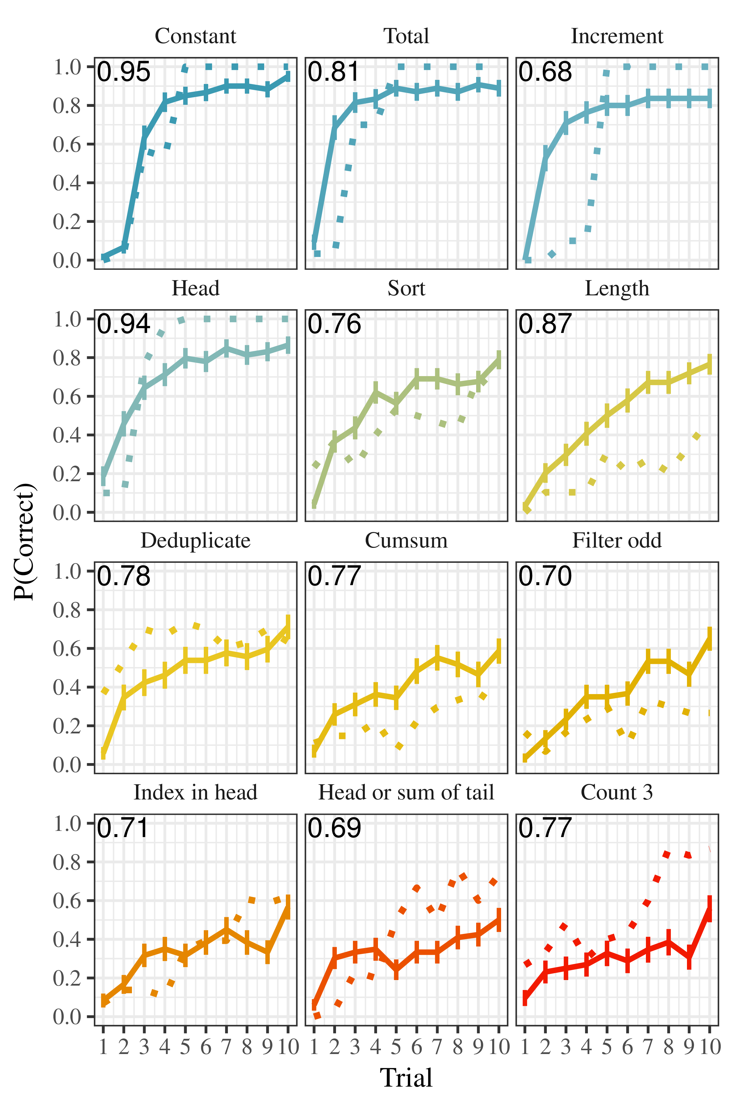
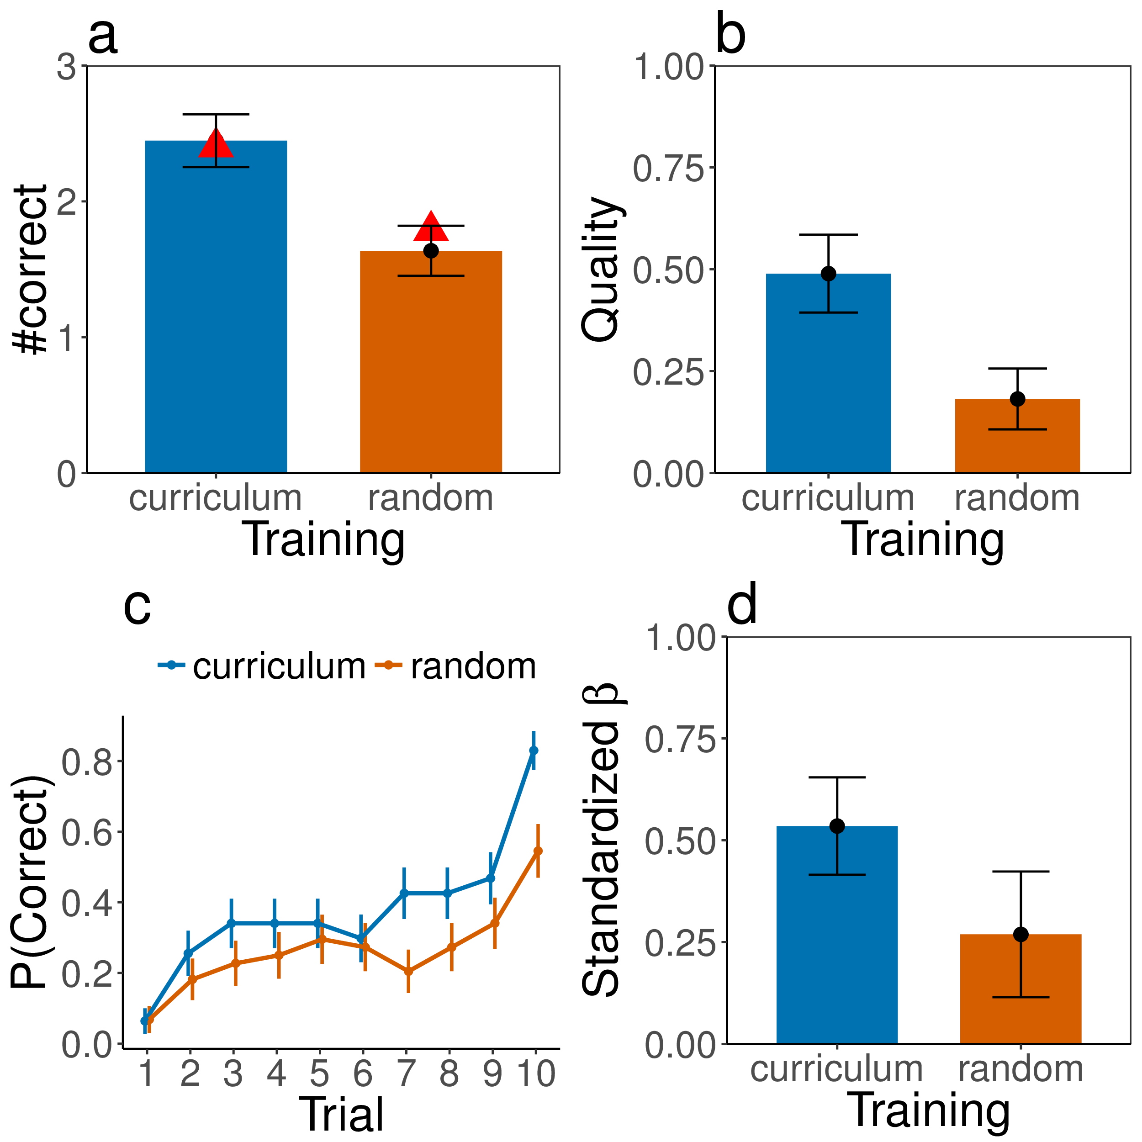
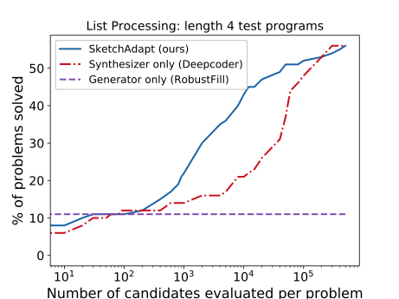
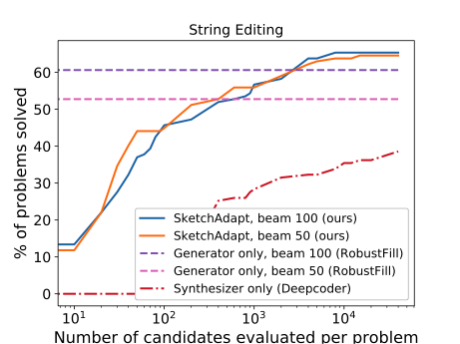
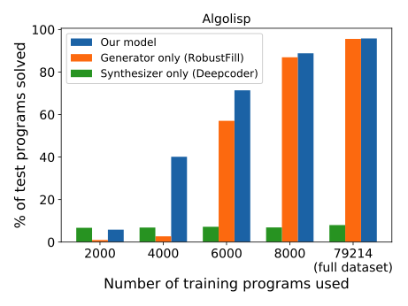
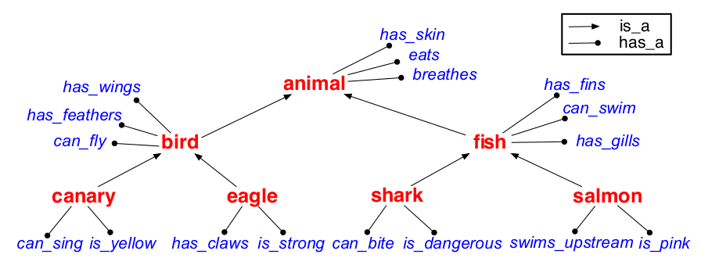
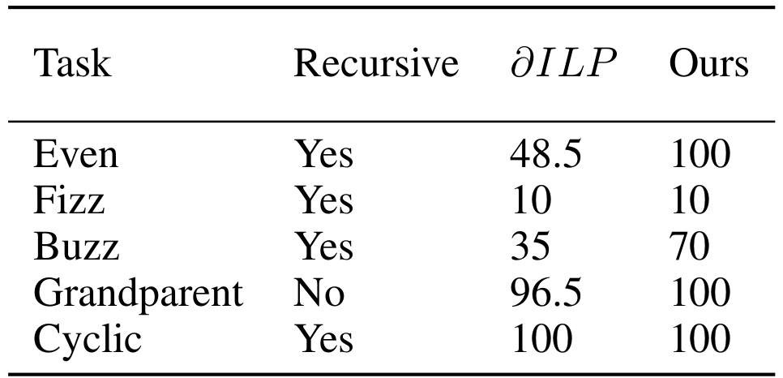
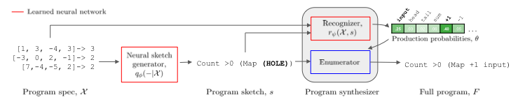
Computational Cognitive Science Group
Dept. of Brain and Cognitive Sciences
Concept Learning as Program Learning
Joshua S. Rule, Andrés Campero,
Maxwell Nye, Joshua B. Tenenbaum
Learning List Concepts through Program Induction
Learning to Infer Program Sketches
Logical Rule Induction via Neural Theorem Proving
Problem: Model human learning of
structured concepts in two online
experiments using a game-based
paradigm.
Problem: Build systems which write code automatically from the kinds of specifications humans can easily provide, such as examples and natural language instruction.
Problem: Transform a knowledge base of observations (left) into a logical theory containing generalized predicates and core facts (right).
[grandfatherOf, ABE, BART].
[fatherOf, ABE, HOMER].
[fatherOf, HOMER, BART].
[parentOf, ABE, HOMER].
[parentOf, HOMER, BART].
[fatherOf, JAMES, HARRY].
[parentOf, LILY, HARRY].
...
[grandfatherOf, X, Y] :-
[[fatherOf, X, Z], [parentOf, Z, Y]].
[parentOf, X, Y] :- [fatherOf, X, Y].
[parentOf, X, Y] :- [motherOf, X, Y].
[fatherOf, ABE, HOMER].
[fatherOf, HOMER, BART].
[motherOf, LILY, HARRY].
...
Spec | Program
[2,3,4,5,6] → [2,4,6] [5,8,3,2,1,12] → [8,2,12] | filter(input, x: x%2==0)
Given an array of numbers, your task is to compute the median of the given array with its digits reversed. | (reduce(reverse(digits(deref (sort a) (/ (len a) 2)))) 0 (lambda2 (+(* arg1 10) arg2)))
Approach: Search over rewrite systems (top) to learn concepts (bottom).
Approach: Learn programs using neuro-symbolic induction. This overview shows one reasoning step.
Approach: Learn Program sketches, which serve as an intermediate between pattern recognition and explicit search approaches.
the larger of head or summed tail
Results: This approach accurately models overall (left) and per-trial performance (middle) in Exp. 1, and predicts curriculum training outperforming random training in Exp. 2.
Results: This approach can synthesize programs more accurately than baselines in a variety of domains: list processing from examples (left), text editing from examples (middle), and character and list manipulation from language description (right).
Results: This approach recovers taxonomic relations (left) and out-performs previous state-of-the-art on a variety of problems (right; score is percentage of random initializations leading to solution. 𝛿ILP is previous state-of-the-art (Evans, Grefenstette, 2018)).

